Slide 1

Cipher Chain
Enterprise Crypto Intelligence & User Management Platform
A production-ready solution merging real-time financial analytics with robust enterprise security protocols.
Team Members:
Project Details
~ Mohammed Mominuddin
~ Shreram
Course: CMPE – Enterprise Technologies

Slide 2




The Enterprise Gap: Defining the Problem
While basic dashboards are common, financial platforms operate under strict constraints. Traditional projects often lack the rigorous security infrastructure required for enterprise deployment.
Secure Authentication SSO
Role Based access control
Robust protection against unauthorised access is non-negotiable.
Strict delineation between administrators and standard users.
Compliance Audit Logging
Real-time Analytical Dashboard
Detailed audit trails for every system interaction.
Live market data integration rather than static displays.

Slide 3



Solution Overview: Cipher Chain
Cipher Chain bridges the gap between academic prototypes and industry standards by prioritising scalability and security.
Secure Onboarding
Seamless access via Google SSO and email authentication, integrated directly into the enterprise workflow.
RBAC Implementation
Full Admin Console
sophisticated Role-Based Access Control system securing sensitive administrative functions.
A dedicated interface for user governance, profile management, and system oversight.

Slide 4
Key System Features
A comprehensive suite of tools designed for both system administrators and financial analysts.
Authentication
Advanced Charting
Flexible login options supporting both standard Email/Password and Google OAuth SSO.
Integration of TradingView libraries for professional-grade technical analysis.
Granular Access Control
Market Intelligence
Distinct environments for Admins (Governance) and Users (Analytics).
Real-time tracking of major indices including NIFTY, SENSEX.
Activity Auditing
User Management
Immutable logs tracking all critical system events for compliance.
Complete administrative control over user lifecycles and permissions.

Slide 5
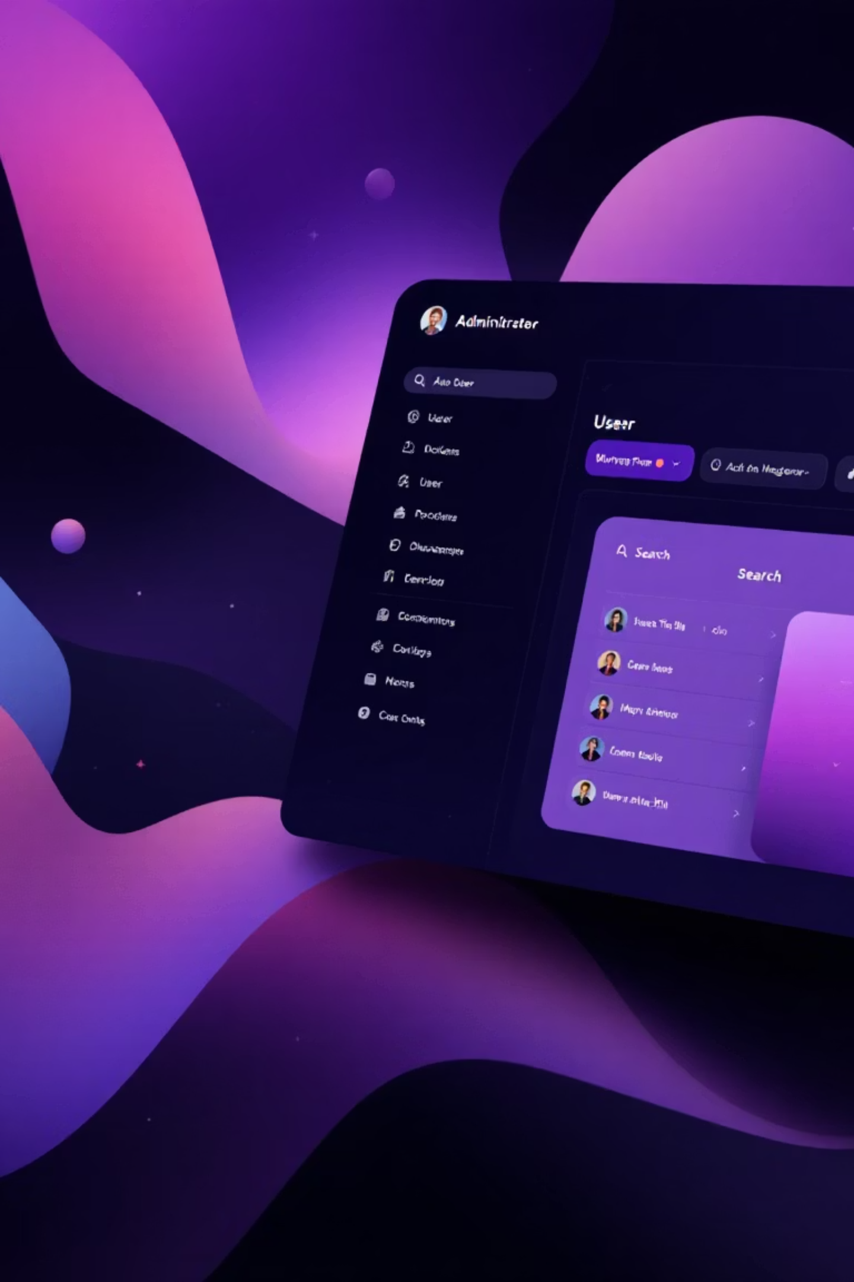

Governance: The Admin Dashboard
The command centre for system oversight, designed to ensure compliance and manage the user base effectively.
User Surveillance
View complete profiles, login timestamps, and current status for every registered user.
Access Control Actions
Instantly enable or disable accounts to handle security threats or subscription statuses.
Data Management
Execute permanent profile deletions and search the user database efficiently.
Audit Monitoring
Review system-wide logs to investigate suspicious behaviour or confirm actions.

Slide 6
The Audit Logging System
In enterprise fintech, accountability is paramount. Cipher Chain maintains a tamper-proof record in the auditLogs Firestore collection.
Access Events
1
Logs capture every Sign-up, Email login, Google SSO entry, and Logout event.
2
Navigation Events
Tracks movement through sensitive areas, such as Dashboard views and Insights navigation.
Administrative Actions
3
Critical modification events (User Disable/Enable/Delete) are recorded with high priority.
4
Compliance Utility
Data is structured for security investigations and regulatory compliance checks.

Slide 7
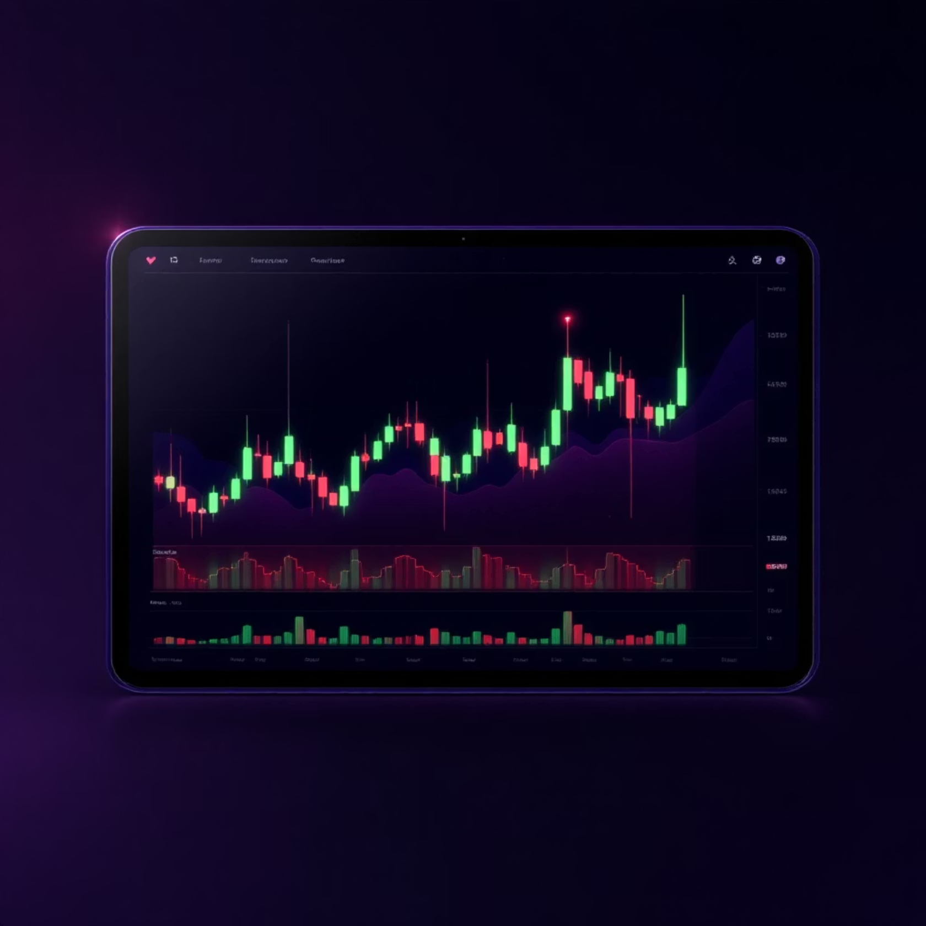
Crypto Intelligence Dashboard
Providing users with professional-grade tools for real-time investment decision making.
Live Technical Charts
Interactive BTC/USDT TradingView charts allowing for deep technical analysis within the platform.
Global Indices
Real-time monitoring of traditional markets (S&P500, NIFTY) alongside crypto assets.
Market News Integration
Aggregated financial news feeds to keep investors informed of macro trends.

Slide 8

System Architecture
A modern Single Page Application (SPA) leveraging serverless cloud power for maximum performance.
Frontend (React Ecosystem)
Backend (Firebase Suite)
Identity: Firebase Auth managing SSO and sessions.
Routing: React Router for seamless navigation.
Database: Firestore NoSQL for User & Audit data.
Styling: Tailwind CSS for responsive, utility-first design.
Security: Custom Claims & Firestore Security Rules.
State: Context API for global data management.
Infrastructure: Fully serverless; no backend maintenance.
Integration: Native embedding of TradingView widgets.

Slide 9


Conclusion
Cipher Chain successfully delivers a secure, scalable, and production-ready fintech platform.
Enterprise Security
Modern UX
Demonstrates RBAC and rigorous audit logging.
Real-time analytics in a cloud-native environment.
Thank You

